Slide 1
Chapter 19 Generics

Slide 2
Objectives
To know the benefits of generics (§19.1).
To use generic classes and interfaces (§19.2).
To declare generic classes and interfaces (§19.3).
To understand why generic types can improve reliability and readability (§19.3).
To declare and use generic methods and bounded generic types (§19.4).
To use raw types for backward compatibility (§19.5).
To know wildcard types and understand why they are necessary (§19.6).
To convert legacy code using JDK 1.5 generics (§19.7).
To understand that generic type information is erased by the compiler and all instances of a generic class share the same runtime class file (§19.8).
To know certain restrictions on generic types caused by type erasure (§19.8).
To design and implement generic matrix classes (§19.9).

Slide 3
Why Do You Get a Warning?
public class ShowUncheckedWarning {
public static void main(String[] args)
{
ArrayList list = new ArrayList();
list.add("Java Programming");
list.add(120); // runtime error bc put different data-types in list.
}
}
There would be a compile warning on this line

Slide 4
Fix the Warning
public class ShowUncheckedWarning {
public static void main(String[] args) {
ArrayList<String> list =
new ArrayList<String>();
list.add("Java Programming");
list.add(120);// compile error bc I declared ArrayList<String>
}
}
No compile warning on this line.

Slide 5
ArrayLists Are Generic Objects
public class ArrayListDemo {
public static void main(String[] args)
{
ArrayList<String> list = new ArrayList<>();
list.add("Java Programming");
list.add(“Data Structures”);
list.add(“C++ Programming”);
}
}

Slide 6
What is Generics?
Generics in Java means that you are creating a method, class or interface that can be used with several different types of data types, so you don’t have to write a separate one for each data type.
(Instead of saying the words “method, class or interface” over and over, I’m going to use the word thing on this slide.)
When you actually use the generic thing in a program you must specify a concrete type for it right then.
When the program is run, the compiler sets the generic thing up as a method, class or interface of that particular data type. (Sorry, I couldn’t stop myself.)

Slide 7
What is Generics?
Generics is the capability to parameterize types.
For example, you may define a generic list class that stores the elements of a generic type. From this generic class, you may create a list object for holding strings and a list object for holding numbers. Here, strings and numbers are concrete types that replace the generic type.

Slide 8
What is Generics?
(Instead of saying “method, class or interface” over and over, I’m going to use the word thing on this slide.)
The data types you use as parameters for generic things must be reference types (Double, Integer, Character, String, etc.)
They cannot be primitive data types like int, char, double, …

Slide 9
Why Use Generics?
(Instead of saying “method, class or interface” over and over, I’m going to use the word thing on this slide.)
One benefit of generics is that errors can be detected at compile time rather than at runtime.
A generic thing lets you specify which types of objects that it can work with. If you attempt to use it with the wrong type, a compile error occurs.
Compile errors are much easier to find and fix than runtime errors. (Plus, for some systems, a runtime error could be disastrous - like nuclear reactors or airplanes……)
It also means that you don’t have to cast values when you get them out of collection structures like ArrayLists

Slide 10
Generic Type
Generic Instantiation
Runtime error
Improves reliability
Compile error

Slide 11
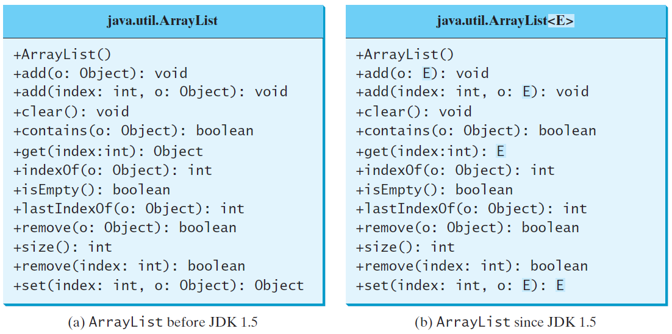
Generic ArrayList in JDK 1.5

Slide 12
No Casting Needed
ArrayList<Double> list = new ArrayList<>();
list.add(5.5); // 5.5 is automatically converted to new Double(5.5)
list.add(3.0); // 3.0 is automatically converted to new Double(3.0)
Double doubleObject = list.get(0); // No casting is needed
double d = list.get(1); // Automatically converted to double

Slide 13
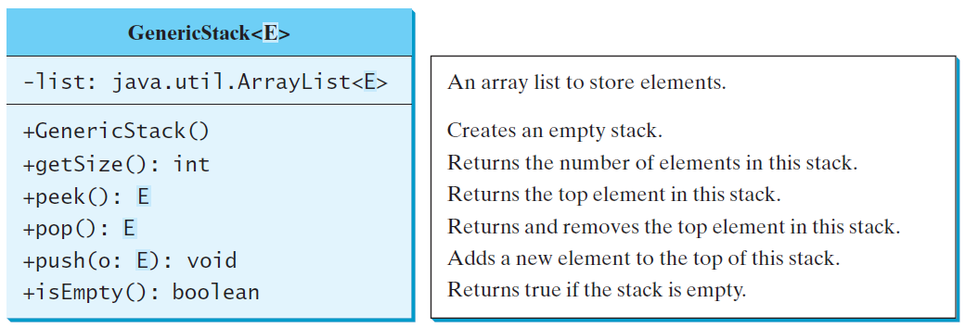
Declaring Generic Classes and Interfaces
GenericStack

Slide 14
Generic Static Classes
public class SomeThing<E>
{
public E item;
public void setThing(E e)
{ this.item = e; }
public E getThing()
{ return item; }
}
The type parameter comes after the class name
Using that data
public static void main(String[] args)
{
SomeThing<String> s1 = new SomeThing<>(); //
SomeThing <Double> d1 = new SomeThing <>();
String name = “Helen Smith”;
Double grade = 85.3;
s1.setThing(name);
d1.setThing(grade);
System.out.println(s1.getThing());
System.out.println(d1.getThing());
}
Notes:
Không dung được int , double,… ,mà phải dung Integer, Double….

Slide 15
Generic Static Classes
Generic classes can have more than one type sent in as a parameter.
public class name <T1, T2, …, Tn> {……..}
  public class SomeThing<E, F>
  {
  public E item1;
  public F item2;
  public void setThing(E thing1, F thing2)
  {
  item1 = thing1;
  item2 = thing2;
  }
  }
______________(Back in the main class)___________________________
public static void main(String[] args)
{
SomeThing<String, Integer> gadget = new SomeThing<>();
String name = “Ordinary”;
Integer num = 1029;
gadget.setThing(name, num);
}

Slide 16
Generic Static Methods
public static <E> void printList(E[] list)
{
for (int i = 0; i < list.length; i++)
System.out.print(list[i] + " ");
System.out.println();
}
In main method
public static void main(String[] args)
{
String [] colors = {“red”, “blue”, “green”, “pink”};
Integer [] nums = {25,168, 21, 57, 92, 100};
printList(colors);
printList(nums);
}

Slide 17
Generic Interfaces
public interface Gen <E>
{
public void add(E e);
}
public class GenClass <E> implements
GenInterface <E>
{
public E myList;
public void add(E e)
{
myList = e;
}
}

Slide 18
Bounded Generic Type
A generic type can be specified as a subtype of another type.
This is known as a bounded generic type
Example: A method designed to work with numbers would only want to work with numeric types like Integer, Double, etc.

Slide 19
Bounded Generic Type
public static void main(String[] args ) {
Rectangle rectangle = new Rectangle(2, 2);
Circle circle = new Circle (2);
System.out.println("Same area? " +
equalArea(rectangle, circle));
}
public static <E extends GeometricObject> boolean
equalArea(E object1, E object2) {
return object1.getArea() == object2.getArea();
}

Slide 20
Raw Type and Backward Compatibility
A raw type is a generic class without any type arguments.
(A basic nongeneric class/interface is not a raw type.)
Raw types show up in legacy code in older versions of Java (prior to Java 5.0)
// raw type
ArrayList list = new ArrayList();

Slide 21
Raw Type is Unsafe
// Max.java: Find a maximum object
public class Max {
/** Return the maximum between two objects */
public static Comparable max(Comparable o1, Comparable o2) {
if (o1.compareTo(o2) > 0)
return o1;
else
return o2;
}
}
Runtime Error:
Max.max("Welcome", 23); // No compile error

Slide 22
Avoiding Unsafe Raw Types
Use
new ArrayList<ConcreteType>()
Instead of
new ArrayList();
TestArrayListNew

Slide 23
Make it Safe
// Max1.java: Find a maximum object
public class Max1 {
/** Return the maximum between two objects */
public static <E extends Comparable<E>> E max(E o1, E o2) {
if (o1.compareTo(o2) > 0)
return o1;
else
return o2;
}
}
Max.max("Welcome", 23); // this gives a compile error

Slide 24
Wildcards
Why wildcards are necessary? See this example.
WildCardNeedDemo
? unbounded wildcard
? extends T bounded wildcard
? super T lower bound wildcard
AnyWildCardDemo
SuperWildCardDemo

Slide 25
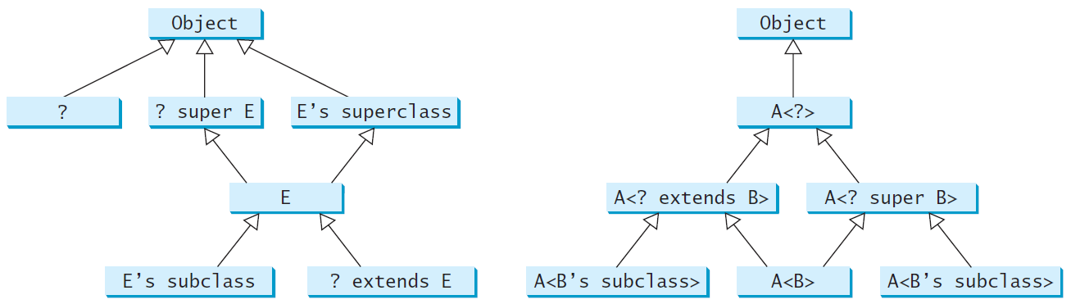
Generic Types and Wildcard Types

Slide 26
Erasure and Restrictions on Generics
Generics are implemented using an approach called type erasure. The compiler uses the generic type information to compile the code, but erases it afterwards. So the generic information is not available at runtime. This approach enables the generic code to be backward-compatible with the legacy code that uses raw types.

Slide 27
Compile Time Checking
For example, the compiler checks whether generics is used correctly for the following code in (a) and translates it into the equivalent code in (b) for runtime use. The code in (b) uses the raw type.

Slide 28
Important Facts
A generic class is shared by all its instances regardless of its actual generic type.
It only exists in one place – there are not multiple copies of the class stored in memory.
  GenericStack<String> stack1 = new GenericStack<>();
  GenericStack<Integer> stack2 = new GenericStack<>();
GenericStack<String> and GenericStack<Integer> above are two types, but there is only one class GenericStack loaded into the JVM.

Slide 29
Restrictions on Generics
Restriction 1: Cannot Create an Instance of a Generic Type. (ex - new E()).
Restriction 2: Generic Array Creation is Not Allowed. (ex - new E[100]).
Restriction 3: A Generic Type Parameter of a Class Is Not Allowed in a Static Context.
Restriction 4: Exception Classes Cannot be Generic.

Slide 30
Designing Generic Matrix Classes
Objective: This example gives a generic class for matrix arithmetic. This class implements matrix addition and multiplication common for all types of matrices.
GenericMatrix

Slide 31
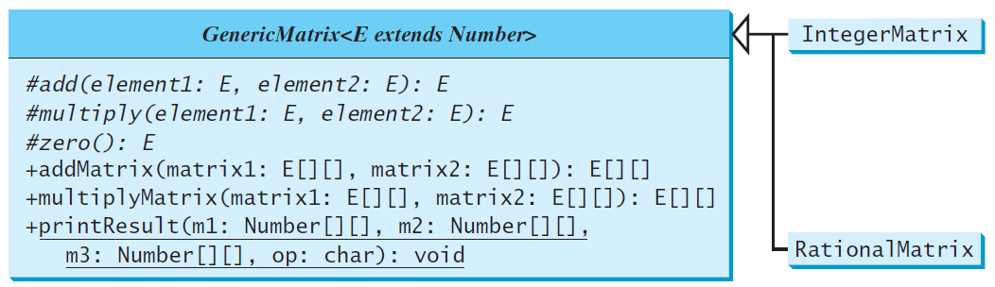
UML Diagram

Slide 32
Source Code
Objective: This example gives two programs that utilize the GenericMatrix class for integer matrix arithmetic and rational matrix arithmetic.
IntegerMatrix
TestIntegerMatrix
RationalMatrix
TestRationalMatrix

